Slide 1
R Case Study from EBAY DDI
李忠 潘佳鸣

Slide 2

R Case Study from EBAY DDI 李忠 潘佳鸣
zholi@ebay.com jipan@ebay.com

Slide 3
Agenda
eBay DDI Introduction
eBay Mobile Buyer Purchase Behavior Analysis Case Study
ETL Failure Message Classification Case Study
Ｑ＆Ａ

Slide 4
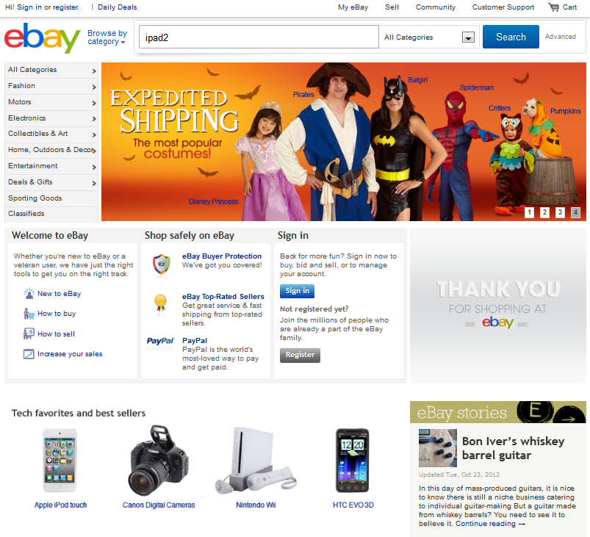
Notes:
Sets stage for what I am going to talk about
Used to be easy, static pages, etc.
Today it is harder – everything is Highly dynamic environment web-page
Everything on site is analytically optimized
Merchandizing, Searching, Anchor experimentation here to drive evolution of website, we test/measure/decide
Agility, fast, can’t wait 4 months to deliver

Slide 5
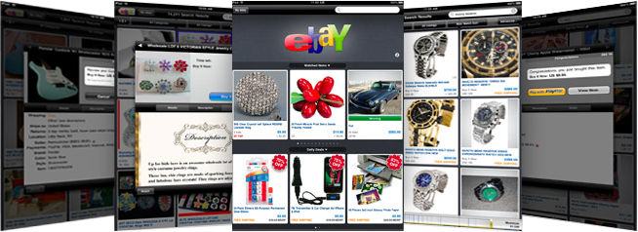
Notes:
Iphone apps – there are multiple apps, fashion, buyer, seller, motors. For android, etc., not just iphone.

Slide 6
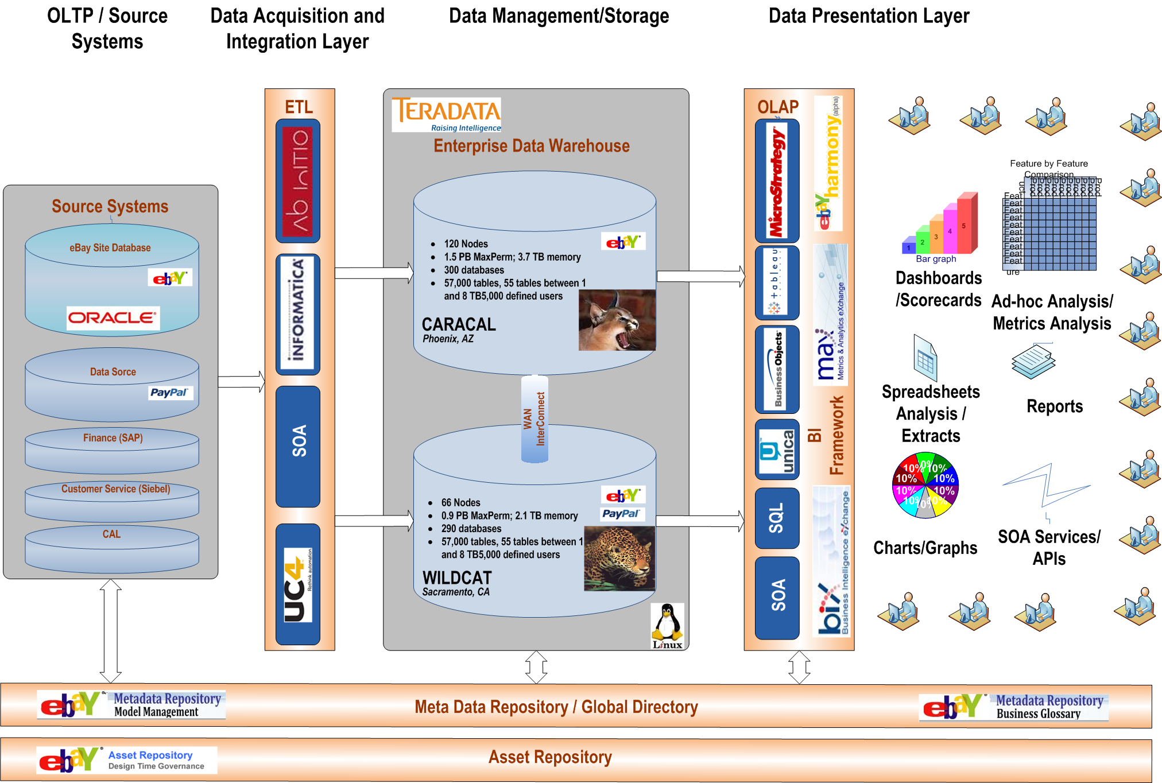

Analytics Platform Architecture
EDW
Singularity
Hadoop

Slide 7


Data Platforms
500+
concurrent users
150+
concurrent users
5-10
concurrent users
Analyze & Report
Discover & Explore
Structured/ SQL
Semi-structured/ SQL++
Unstructured / JAVA&C
Production Data Warehousing
Large Concurrent User-base
Contextual-Complex Analytics
Deep, Seasonal, Consumable Data Sets
Structure the Unstructured
Detect Patterns
Enterprise-class System
Low End Enterprise-class System
Commodity Hardware System
Data Warehouse
Data Warehouse
+ Behavioral
EDW
Singularity
Hadoop
6+PB
40+PB
20+PB
Data Integration
Ab Initio
Informatica
UC4
SOA
Notes:
These platforms are not the same. They are very different. You want to integrate them as much as possible.
1.Structured
Structured data is typically the type of data we work with. Essentially structured data is comprised of a series of observations that share the same variables.
A table with rows and numeric columns is a traditional example. Databases are very good at storing and processing data stored in this format.
Data often has to be transformed before it can be classified structured. There is a cost for this transformation and this process typically requires before-hand knowledge as to what exactly must be extracted and how it is to be extracted.
2.Semi-Structured
Semi-structured data shares characteristics of both structured and unstructured data. It is typically organized into observations with some variables represented in a structured format while others coexist in a less rigid format.
Semi-structured representation is used to:
Facilitate frequent change or high variability of an observation's variables
Reduce the effort and cost of transformation by leaving some data in an unstructured format
Retain the performance and usability aspects of having core variables in a structural format
3.Unstructured
A generalization of unstructured data is that its data is not usable without transformation.
Transformation is typically required to group its data into observations and extract the necessary variables to facilitate further analysis or processing.
Unstructured data requires the least effort to store but the most effort to use.
Hadoop systems the preferred platforms for this type of data.

Slide 8
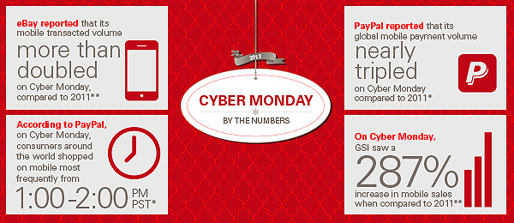
Cyber Monday: By the Numbers
Thanks to the growth of smartphones and tablets, which allow for “anytime, anywhere” shopping,
eBay Inc. saw a surge in mobile commerce this past Cyber Monday across all divisions.
On a year-over-year basis, mobile transacted volume more than doubled in the U.S. for eBay Marketplaces and nearly tripled for PayPal on a global basis. In addition, GSI saw a 287% increase in mobile sales in the U.S., compared to 2011.
PayPal research also noted that consumers around the world shopped on mobile most frequently
from 1:00 p.m. to 2:00 p.m., PST, on Cyber Monday — slightly later in the day than on Thanksgiving
and Black Friday.

Slide 9
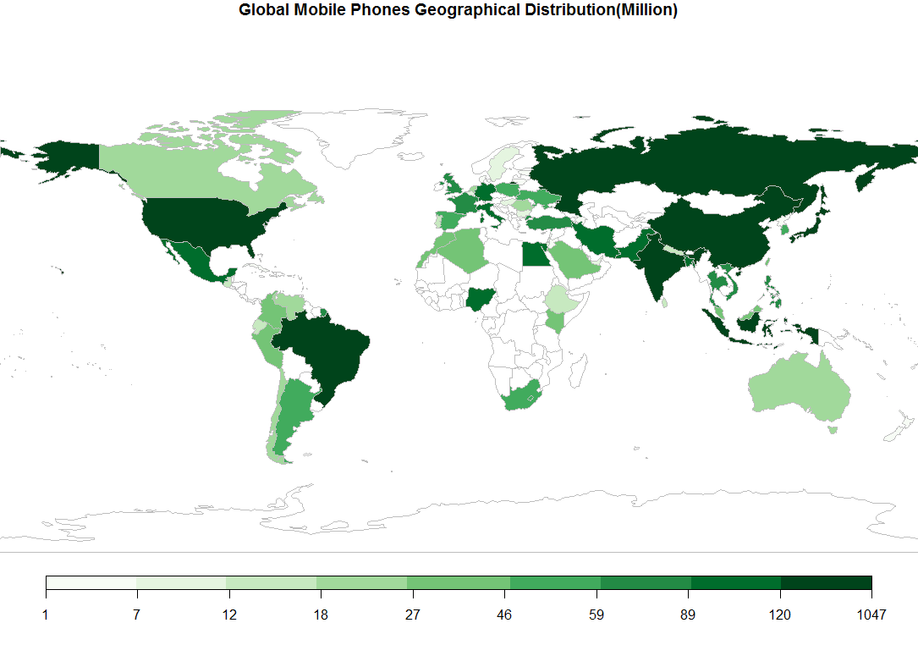
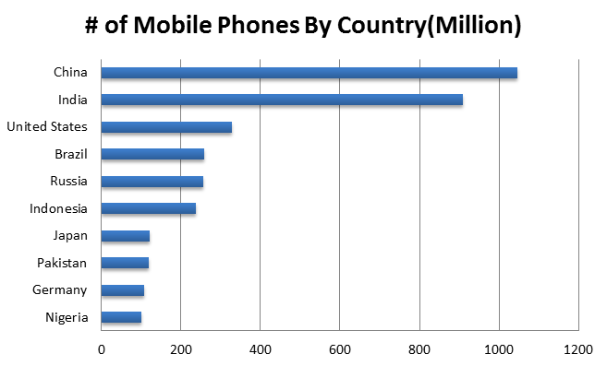
Global Mobile Phones Geographical Distribution
Data Source comes from wiki page:
http://en.wikipedia.org/wiki/List_of_countries_by_number_of_mobile_phones_in_use

Slide 10
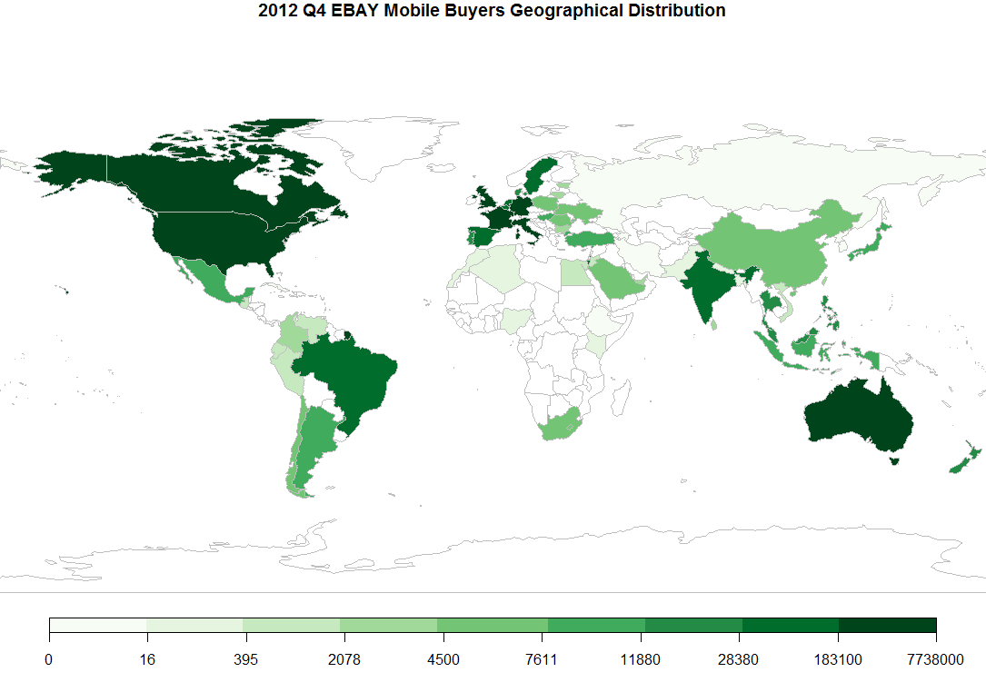
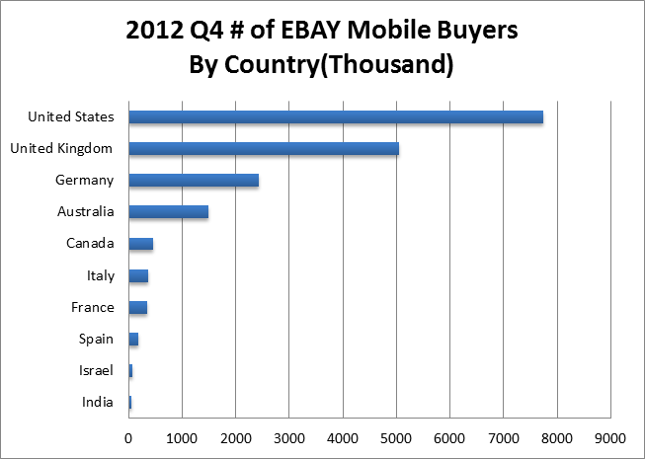
2012 Q4 EBAY Mobile Buyers Geological Distribution

Slide 11
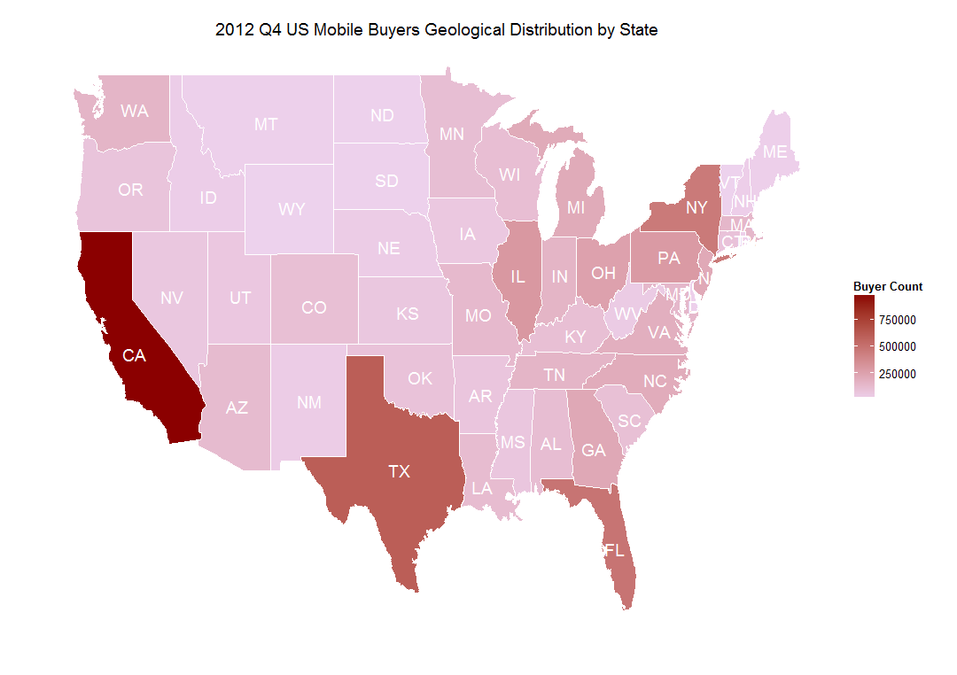
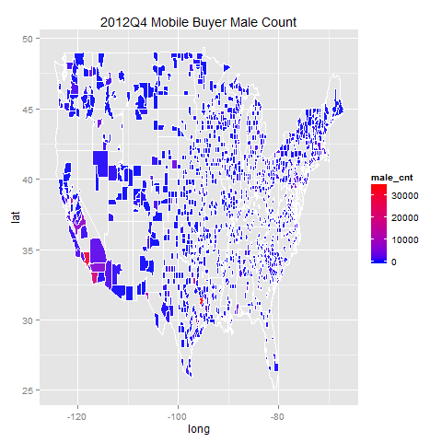
2012 Q4 US Mobile Buyers Geological Distribution

Slide 12
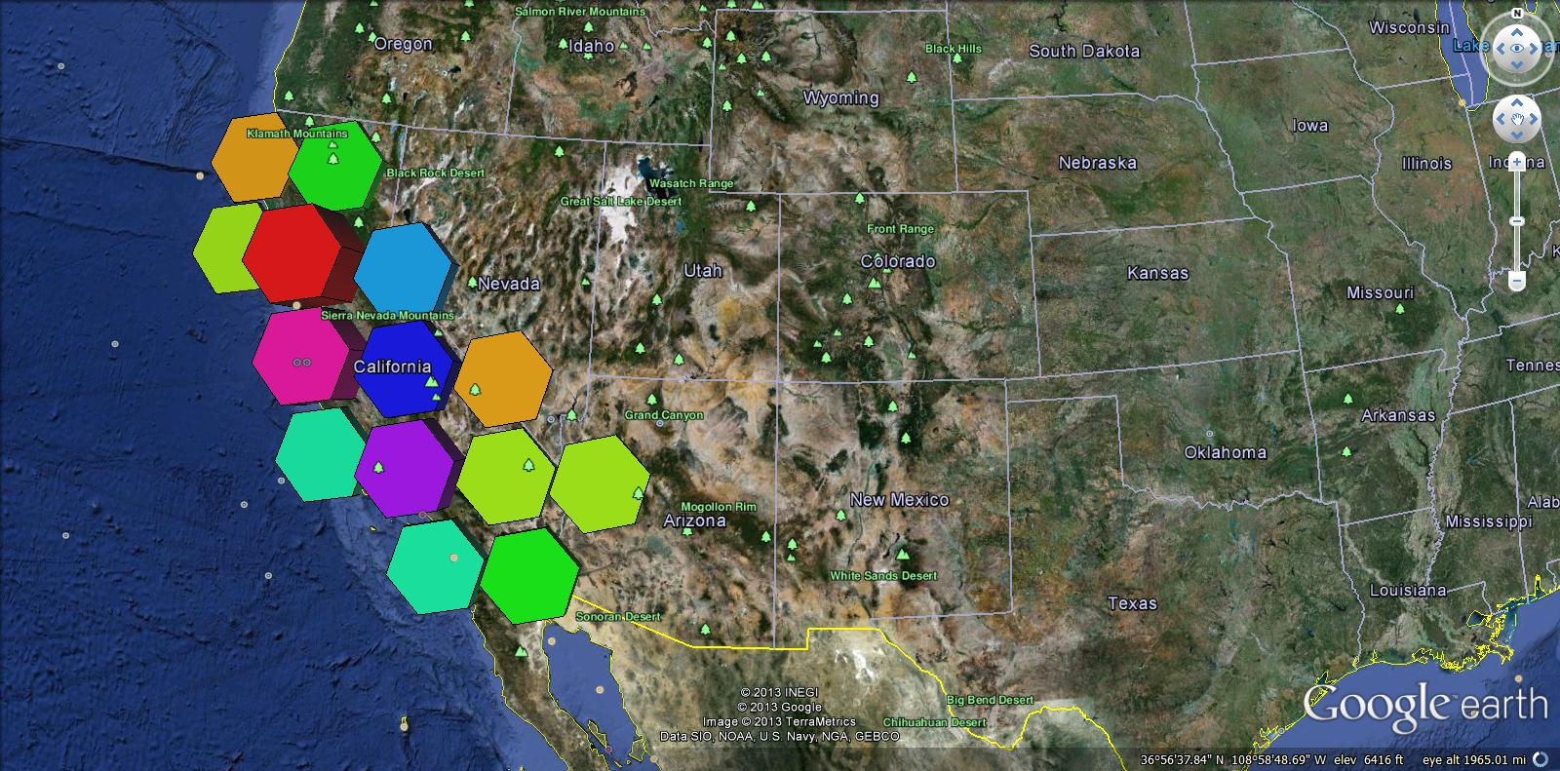
2012 Q4 Mobile Buyer Distribution on GE

Slide 13
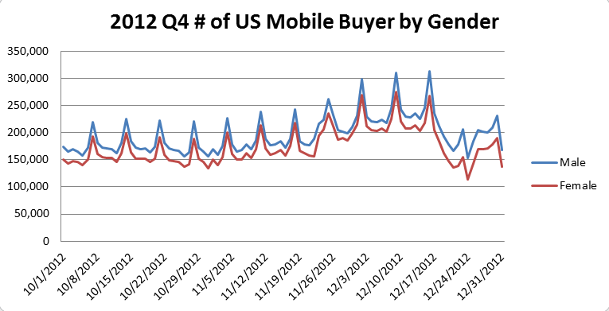
2012 Q4 # of US Mobile Buyer Count by Gender

Slide 14
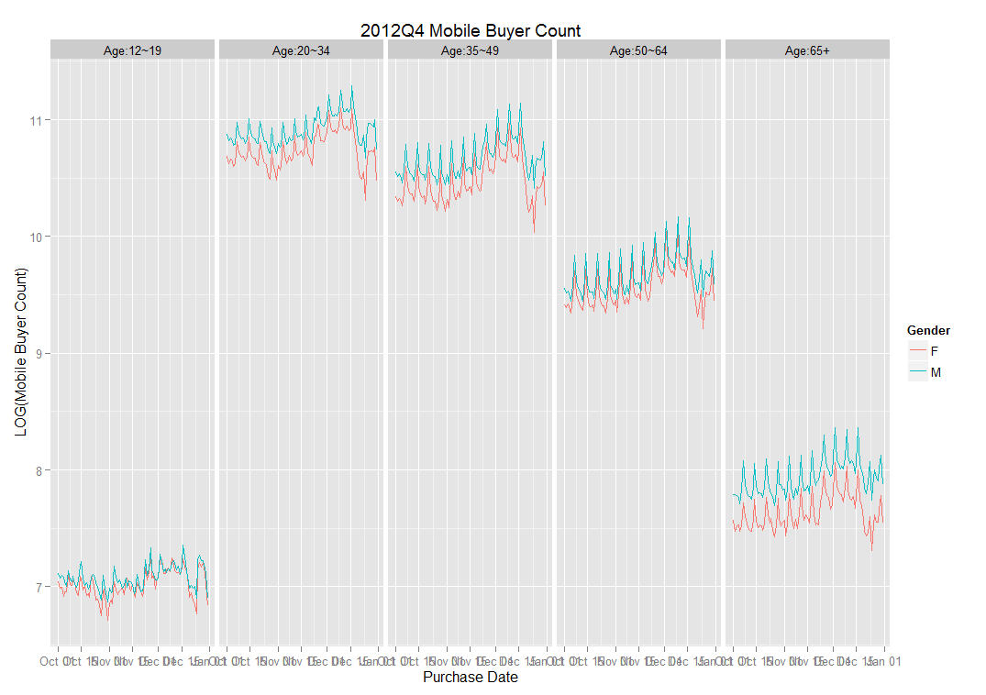
2012 Q4 Mobile Buyer Count by Age Group

Slide 15
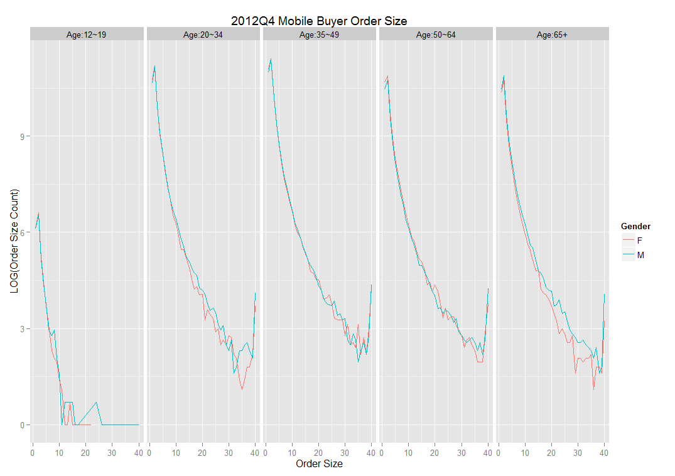
2012 Q4 Mobile Buyer Order Size by Age Group

Slide 16
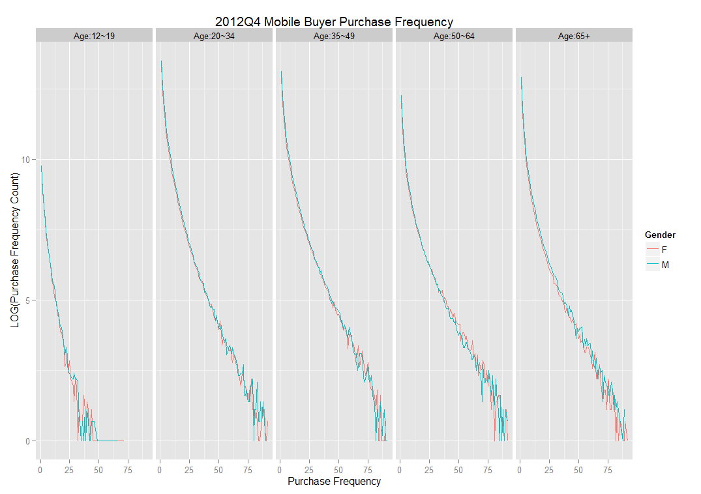
2012 Q4 Mobile Buyer Purchase Frequency by AG

Slide 17
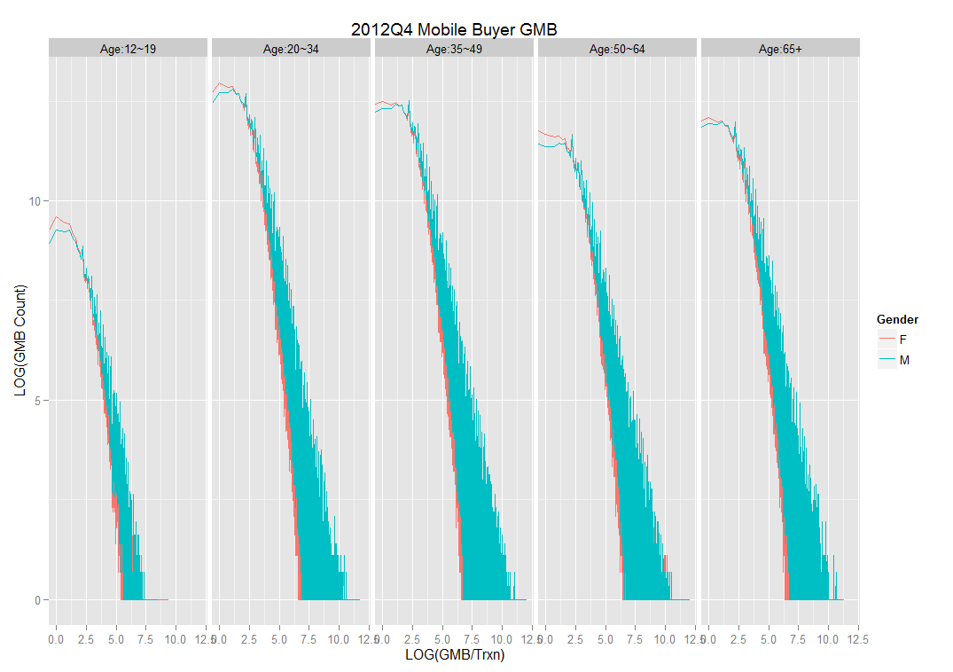
2012 Q4 Mobile Buyer Purchase Amt by Age Group

Slide 18
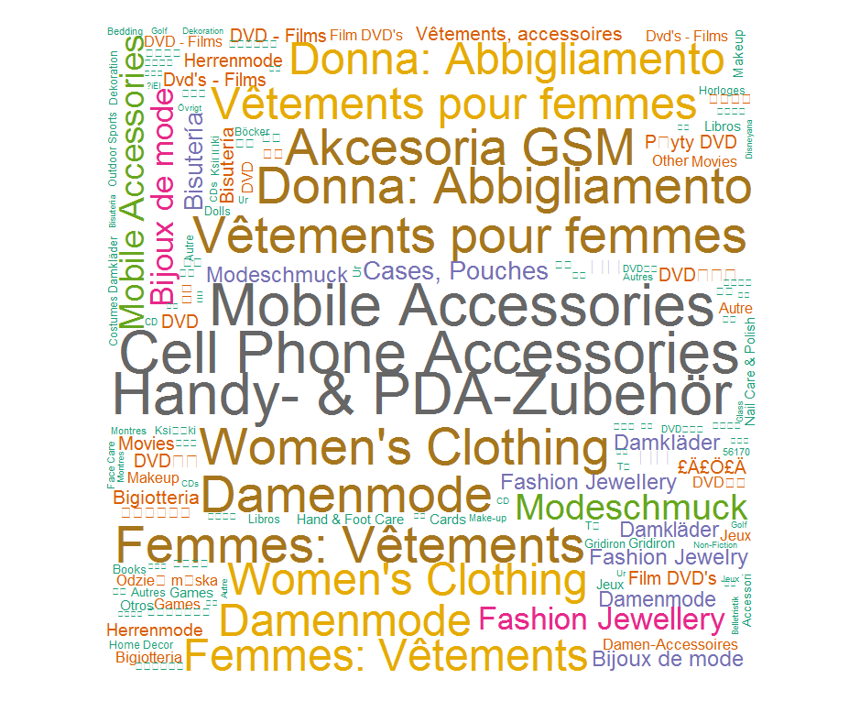
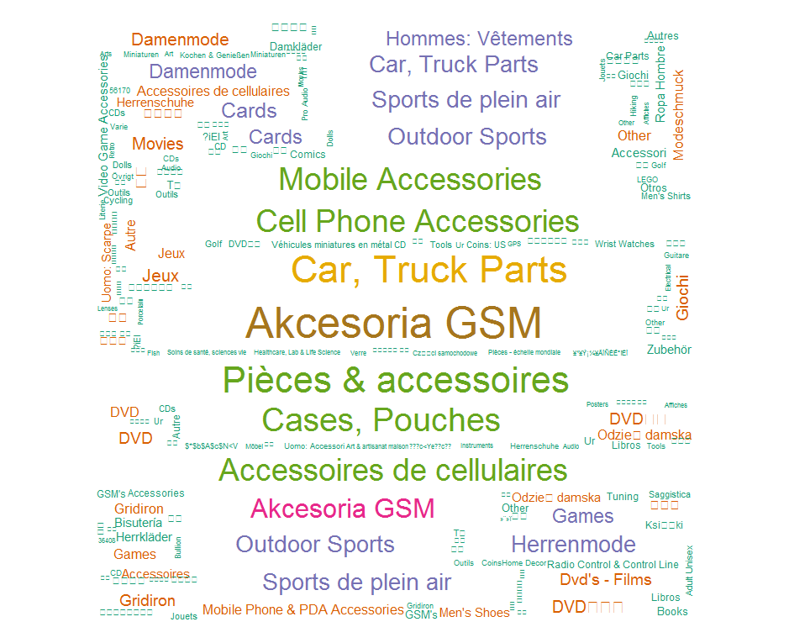
2012 Q4 Mobile Buyer Category Keyword
Mobile Female likes
mobile and clothing
Mobile male likes
Mobile and Car

Slide 19
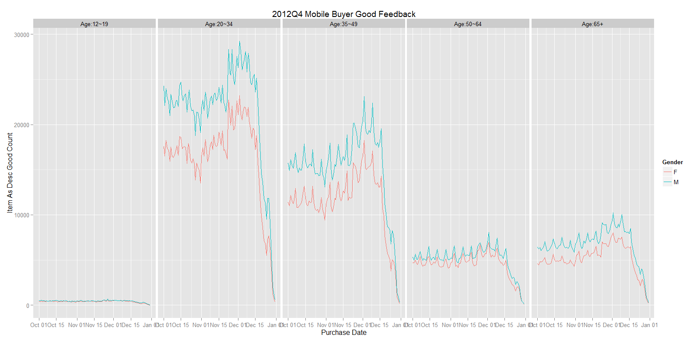
2012 Q4 Mobile Buyer Feedback by Age Group

Slide 20
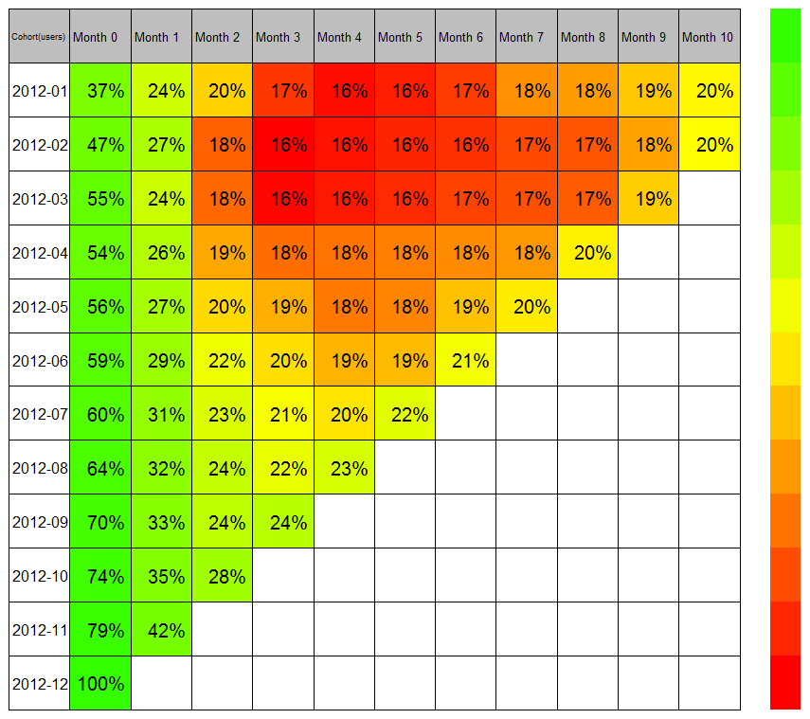
2012 Mobile Buyer Retention Rate

Slide 21
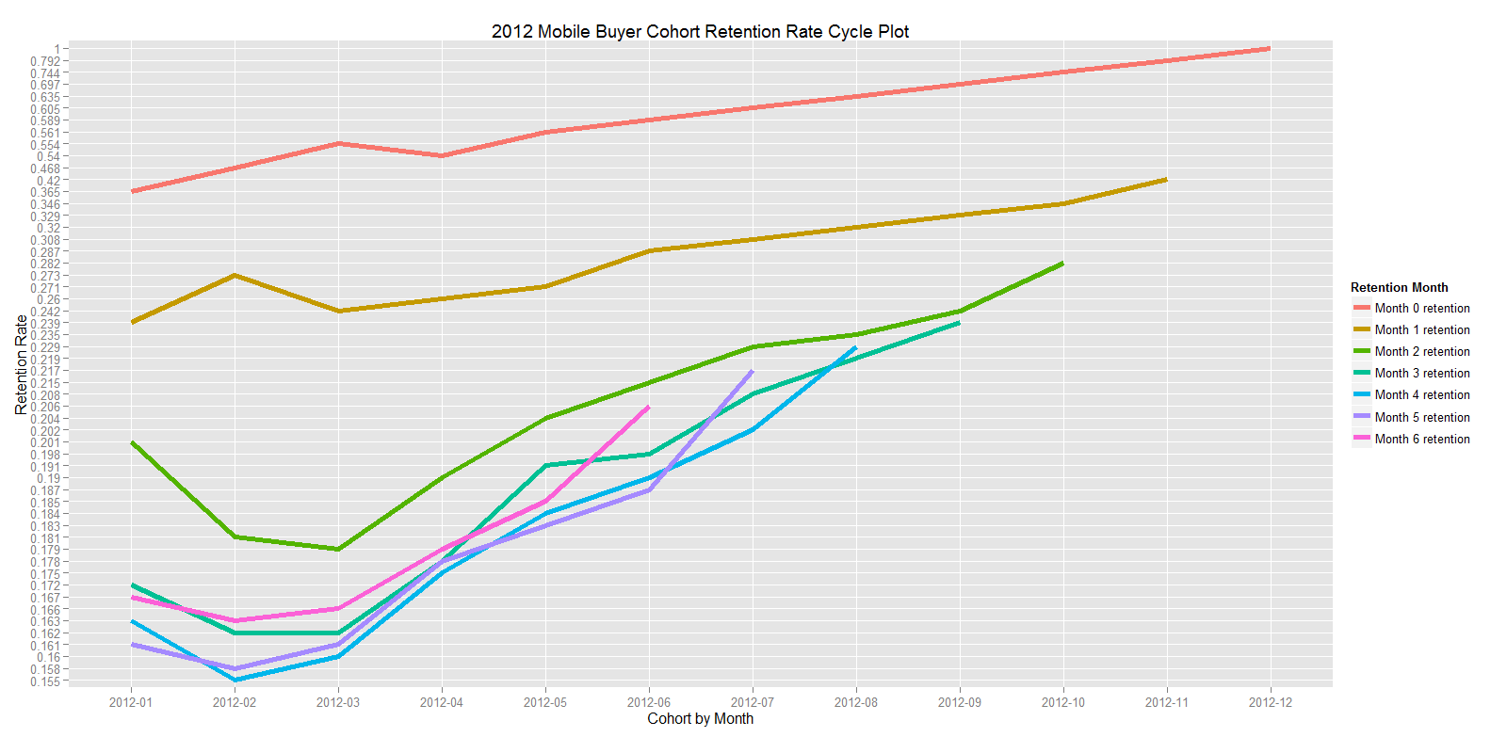
2012 Mobile Buyer Retention Cycle Plot

Slide 22
2012 Q4 Mobile Buyer Analysis Summary
We can see that the top 5 eBay big market places are US,UK,DE,AU and CA, but it is clearly that BRIC countries (Brazil, Russia, India and China) have a big potential business opportunity for EBAY mobile marketplace.
Most mobile buyers came from CA, TX, NY and FL in 2012 Q4.
Mobile male like mobile and car but mobile female like mobile and women’s clothing.
Order size, purchase frequency are nearly the same between mobile male and mobile female, but looks like mobile male spend more GMB per transaction than mobile female.
Age 20~34 and Age 35~49 are the two most active mobile feedback groups and they are satisfied with eBay items.
Retention rate converge to 20%

Slide 23
Data Platforms
500+
concurrent users
150+
concurrent users
5-10
concurrent users
Analyze & Report
Discover & Explore
Structured/ SQL
Semi-structured/ SQL++
Unstructured / JAVA&C
Production Data Warehousing
Large Concurrent User-base
Contextual-Complex Analytics
Deep, Seasonal, Consumable Data Sets
Structure the Unstructured
Detect Patterns
Enterprise-class System
Low End Enterprise-class System
Commodity Hardware System
Batches LOG
Batches LOG
Batches LOG
Data Warehouse
Data Warehouse
+ Behavioral
EDW
Singularity
Hadoop
6+PB
40+PB
20+PB
Batches LOG
Batches LOG
Batches LOG
Batches LOG
Data Integration
Ab Initio
Informatica
UC4
SOA
Notes:
These platforms are not the same. They are very different. You want to integrate them as much as possible.
1.Structured
Structured data is typically the type of data we work with. Essentially structured data is comprised of a series of observations that share the same variables.
A table with rows and numeric columns is a traditional example. Databases are very good at storing and processing data stored in this format.
Data often has to be transformed before it can be classified structured. There is a cost for this transformation and this process typically requires before-hand knowledge as to what exactly must be extracted and how it is to be extracted.
2.Semi-Structured
Semi-structured data shares characteristics of both structured and unstructured data. It is typically organized into observations with some variables represented in a structured format while others coexist in a less rigid format.
Semi-structured representation is used to:
Facilitate frequent change or high variability of an observation's variables
Reduce the effort and cost of transformation by leaving some data in an unstructured format
Retain the performance and usability aspects of having core variables in a structural format
3.Unstructured
A generalization of unstructured data is that its data is not usable without transformation.
Transformation is typically required to group its data into observations and extract the necessary variables to facilitate further analysis or processing.
Unstructured data requires the least effort to store but the most effort to use.
Hadoop systems the preferred platforms for this type of data.

Slide 24
eBay Data Platform Batch Support
Batches LOG
Batches LOG
Batches LOG
Failure Type
Batches LOG
?
Batches LOG
Batches LOG
Batches LOG
Batches LOG

Slide 25
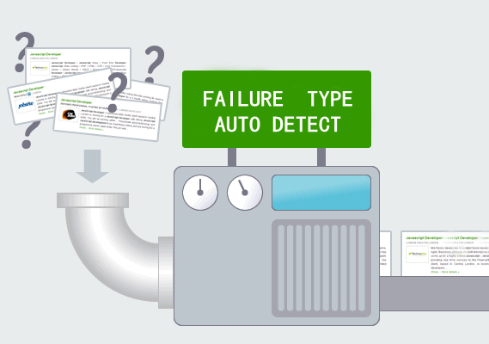
eBay Data Platform Batch Support
The Business Problem
How many types of Batch Failure
How to describe each type of Batch Failure
How to automatically detect Batch Failure

Slide 26
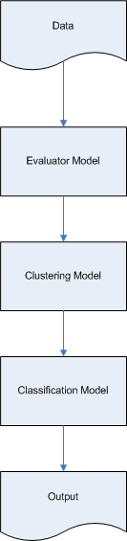

eBay Data Platform Batch Support

Slide 27
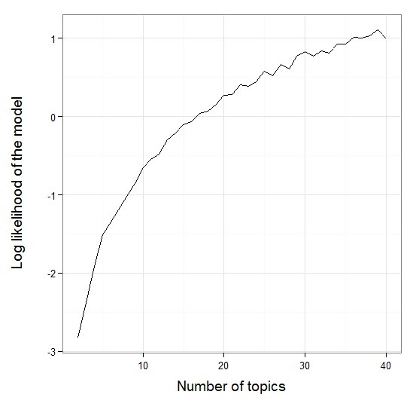
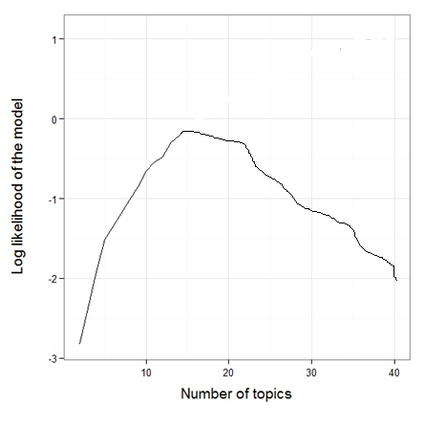
eBay Data Platform Batch Monitoring Center
1st Cycle
Nth Cycle

Slide 28
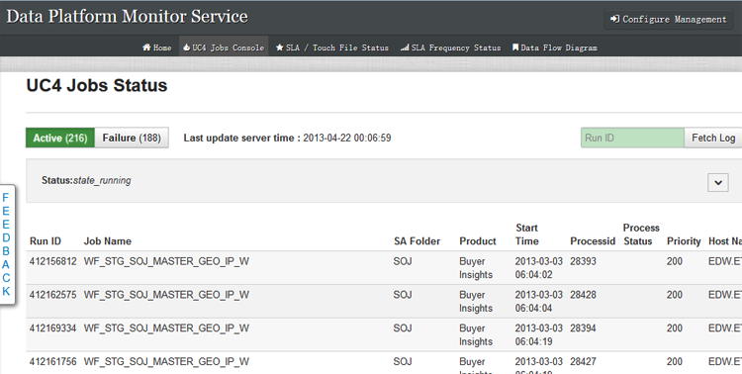
eBay Data Platform Batch Monitoring Center

Slide 29
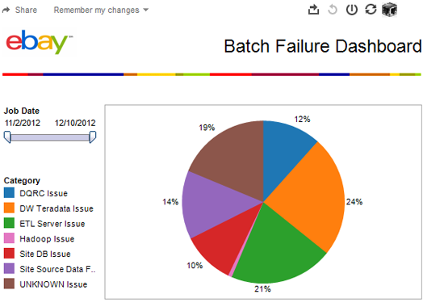
eBay Data Platform Batch Monitoring Center

Slide 30
Thank You

Slide 31
Ｑ&A

